Slide 1


Folium
Creating maps with Leaflet.js on Python

Slide 2
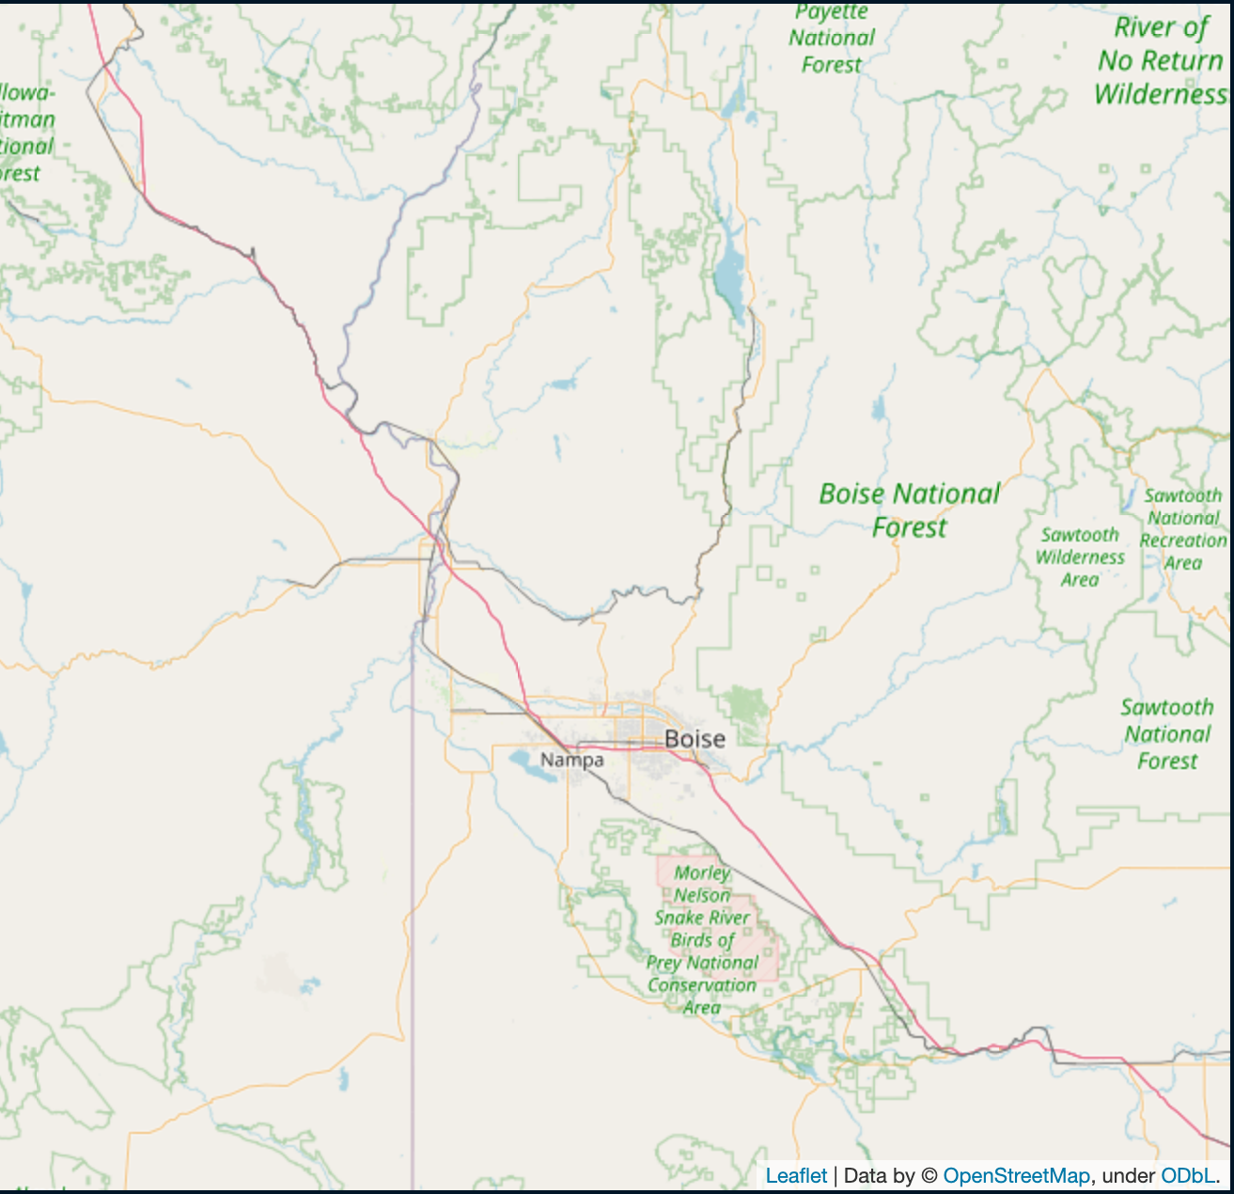
What is Folium?
Create interactive maps on Folium
Created in 2013
Builds on the data wrangling strengths of the Python ecosystem and the mapping strengths of the leaflet.js library

Slide 3
11,500
118
1,475
Users
Contributors
Commits

Slide 4
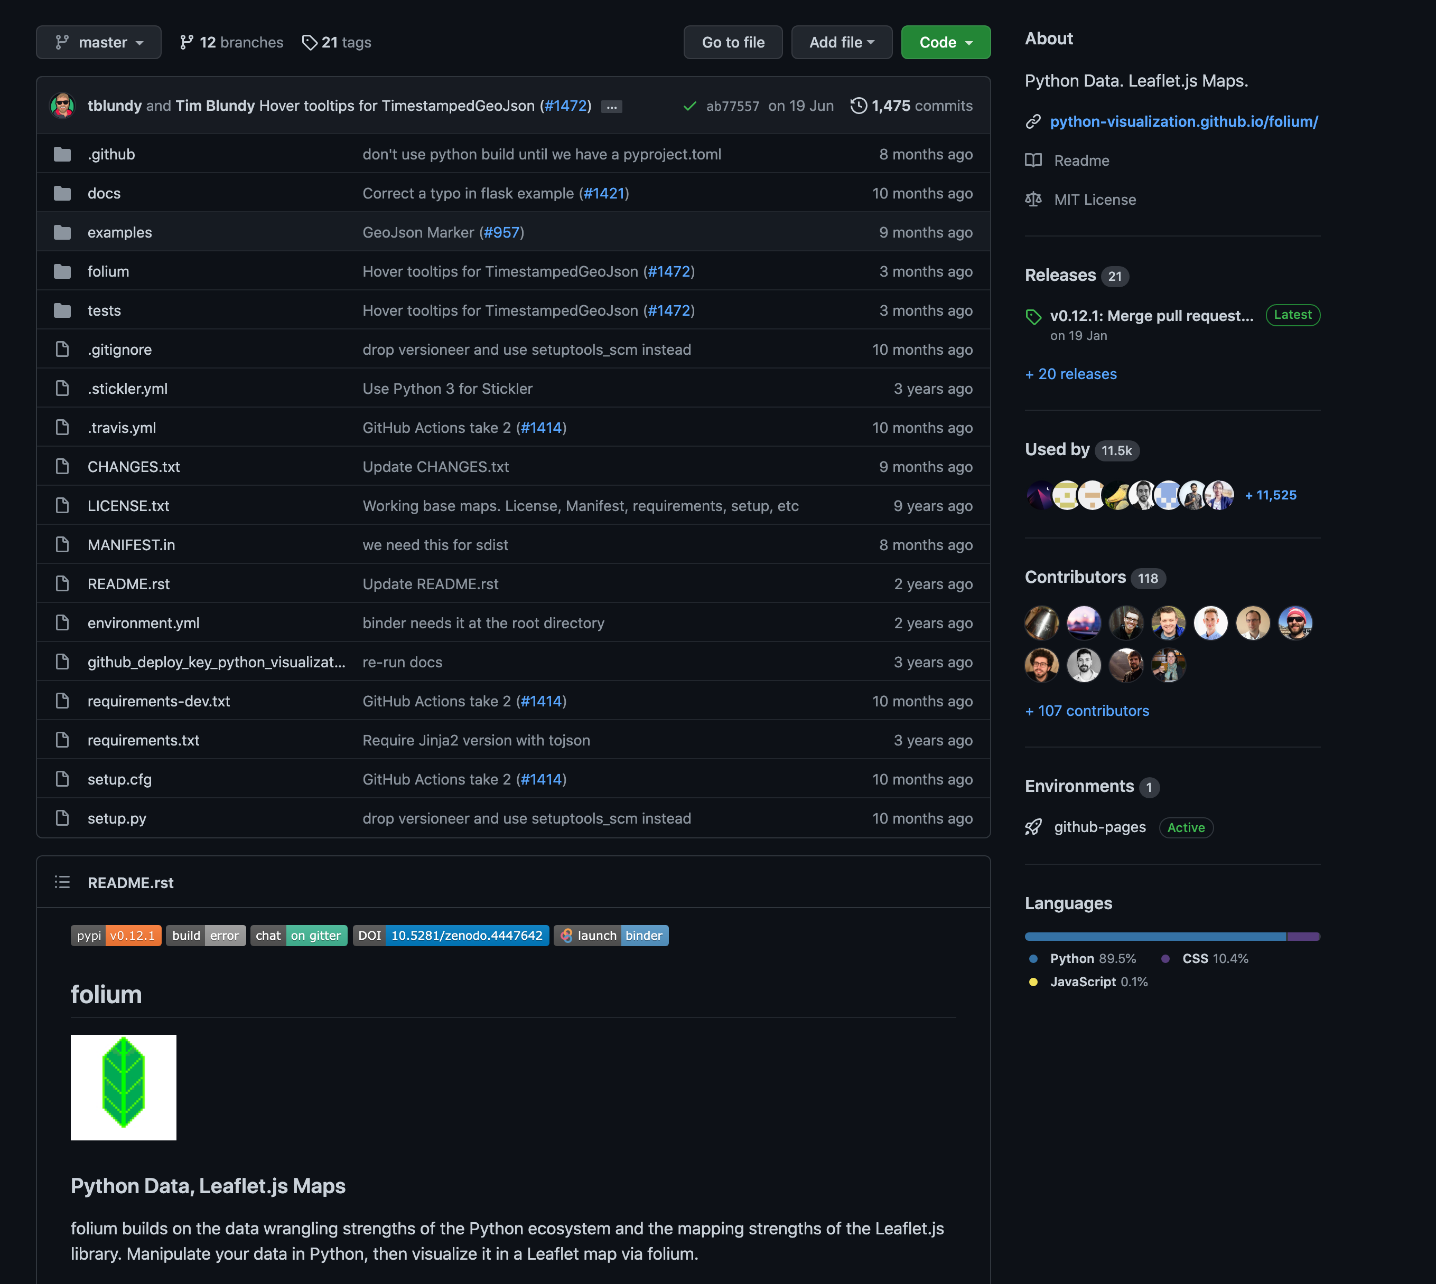
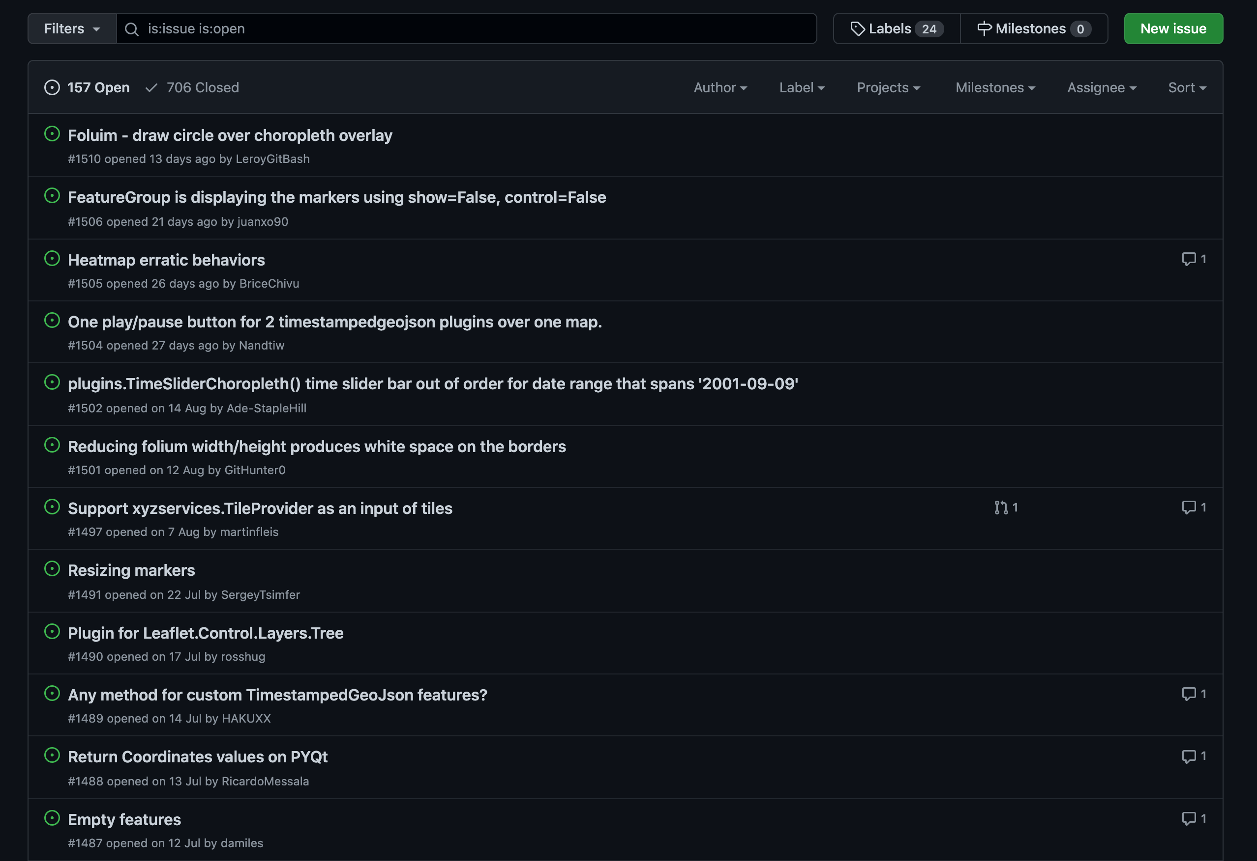
GitHub (/python-visualization/folium)

Slide 5
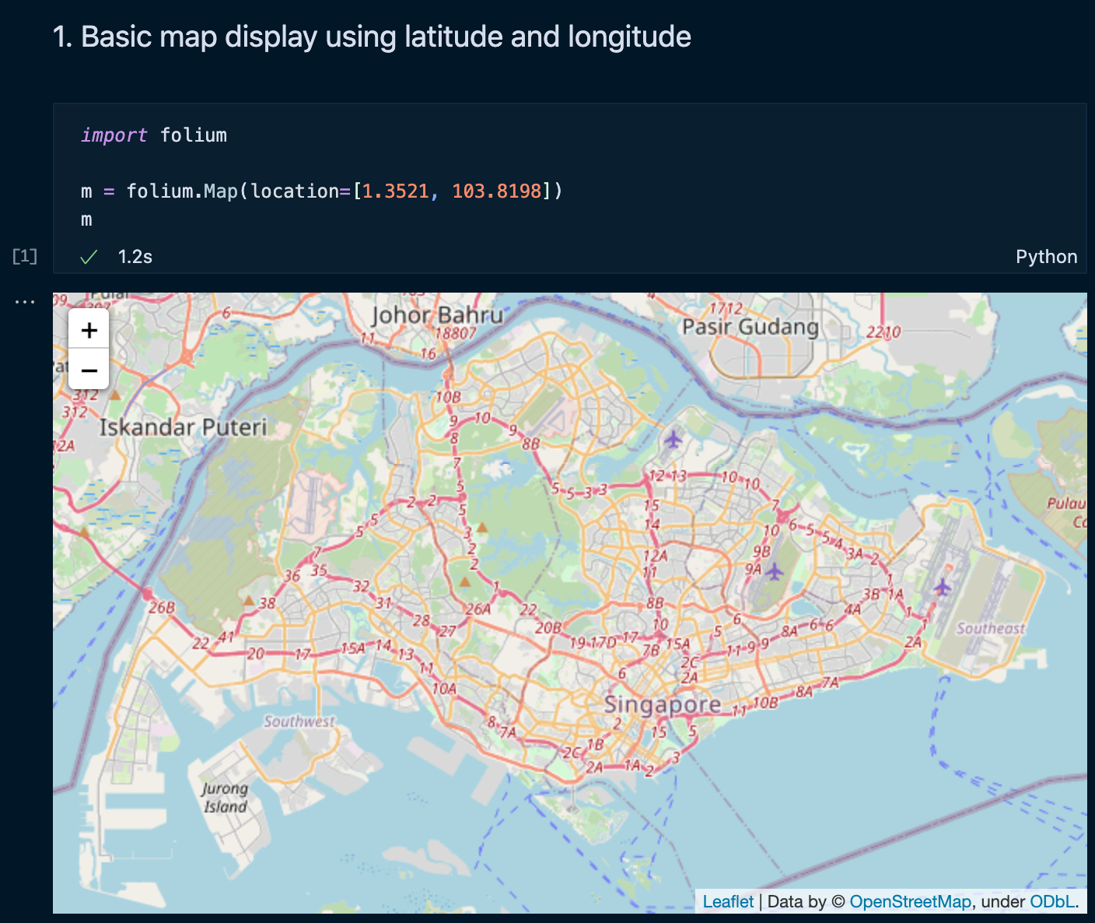
What can you do?
Display maps
Input data onto the maps to visualize your data with markers
Overlay maps on top of maps
Use pandas to create choropleth maps (heatmaps)
Style your maps
Support different tilesets (which map engine to use)

Slide 6
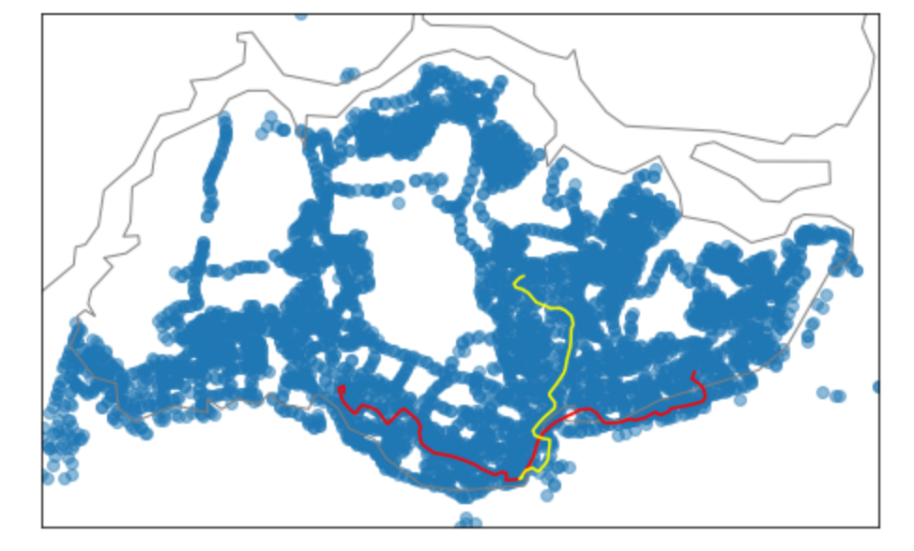
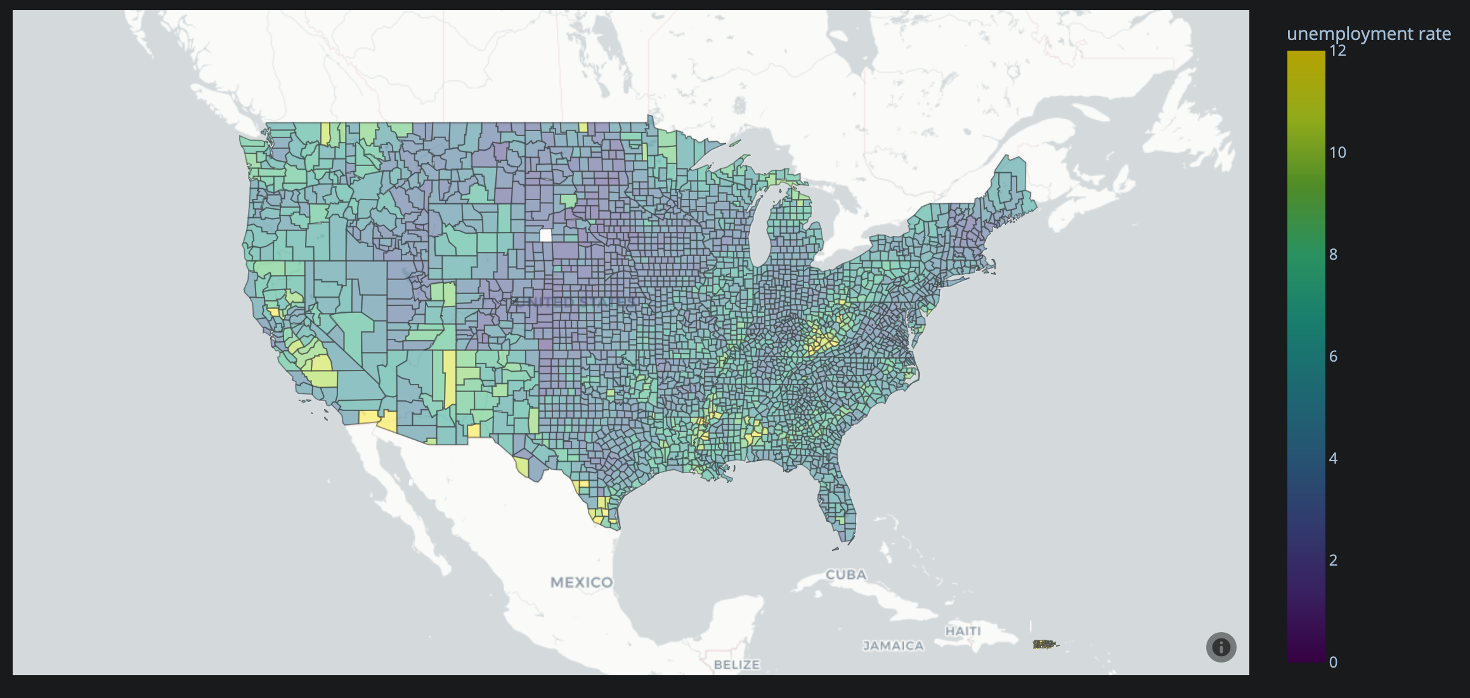
Competitors
Static maps with Matplotlib and Seaborn
Interactive maps with Plotly
Distinguishing features of Folium:
Google Maps experience with minimal code
Able to pan around, built in zooming
Matplotlib map view
Plotly choropleth map

Slide 7
My Review (The Goods)
Easy to Use
Great Customizability
Minimal code for what it does,
Very specialized purpose
Styling of maps and markers,
great integration with Pandas

Slide 8
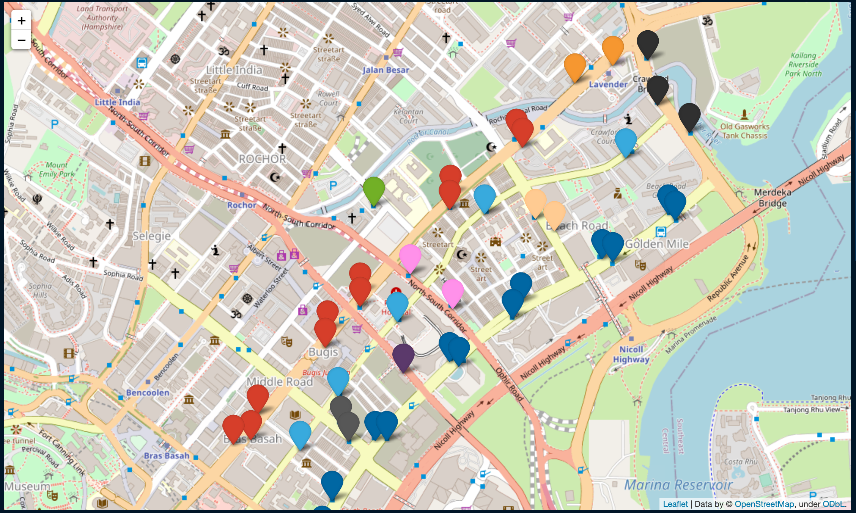
Some Cool Stuff
Color-Coding Bus Stops Based on Road

Slide 9
My Review (The Not So Goods)
Limited Functionality
Cannot Handle Large Data
Only support existing world maps, cannot create a map from scratch
Too much data can cause the map to crash or be extremely slow to render

Slide 10
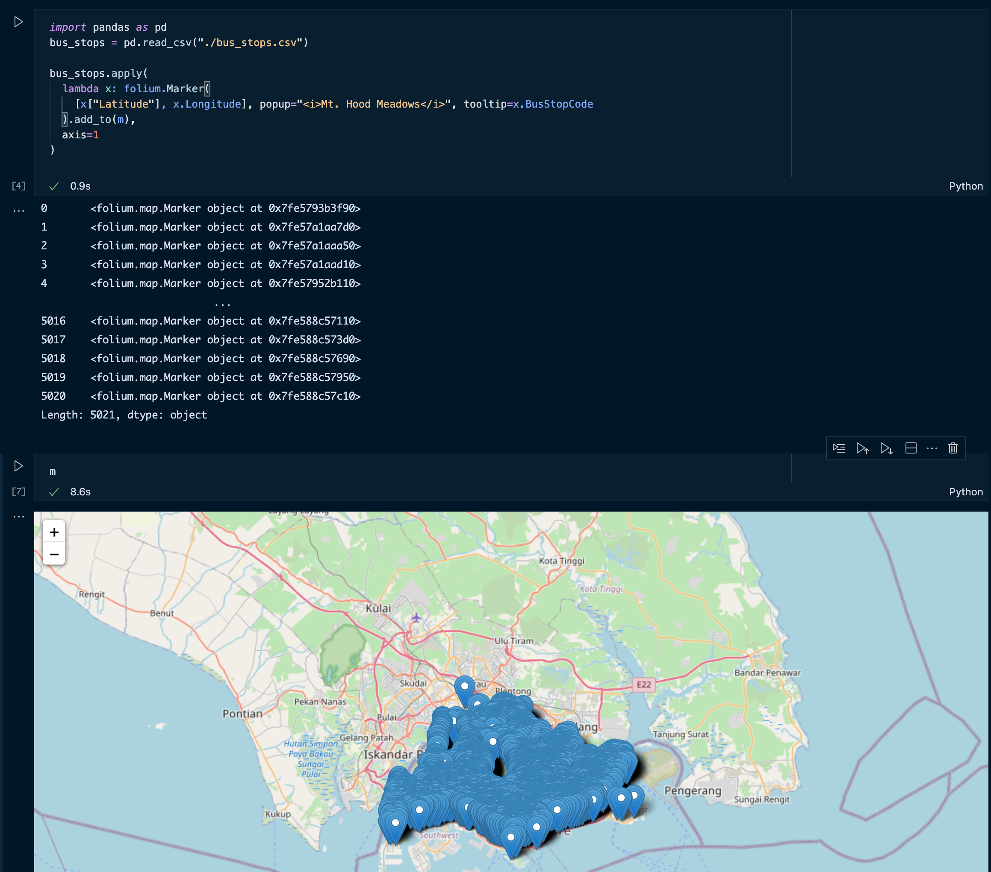
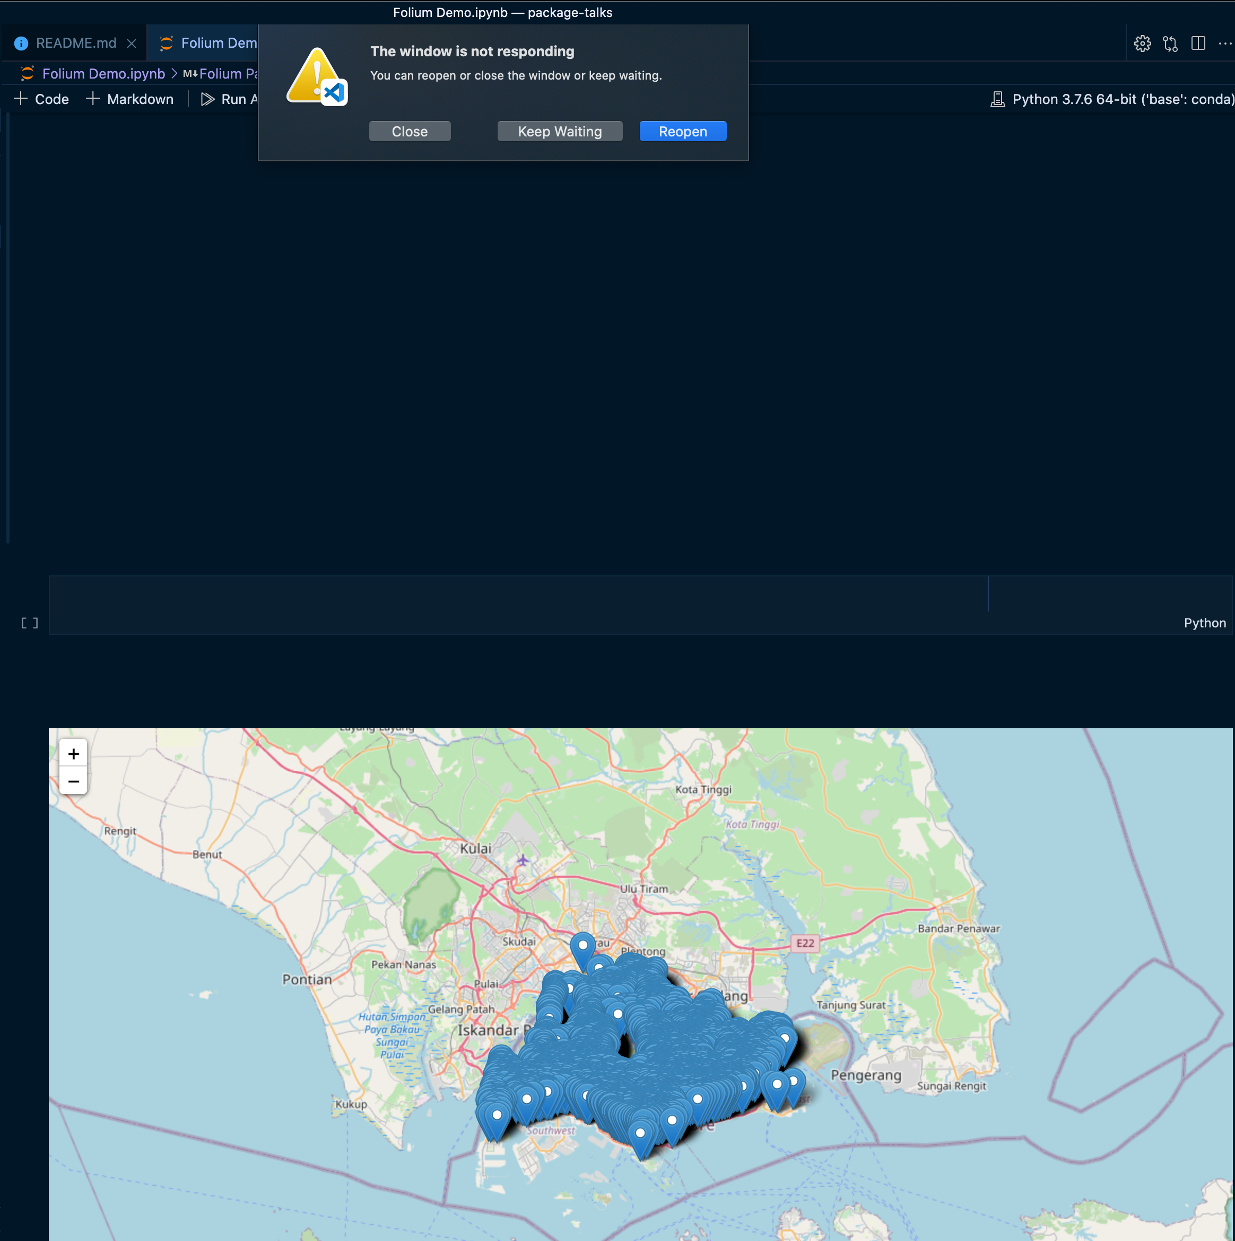
Exploring the Limits
Matplotlib map view
Lagging on large data
Editor crashing due to rendering

Slide 11


Thank You!
Notebook:
https://tinyurl.com/folium-package-demo

